Slide 1
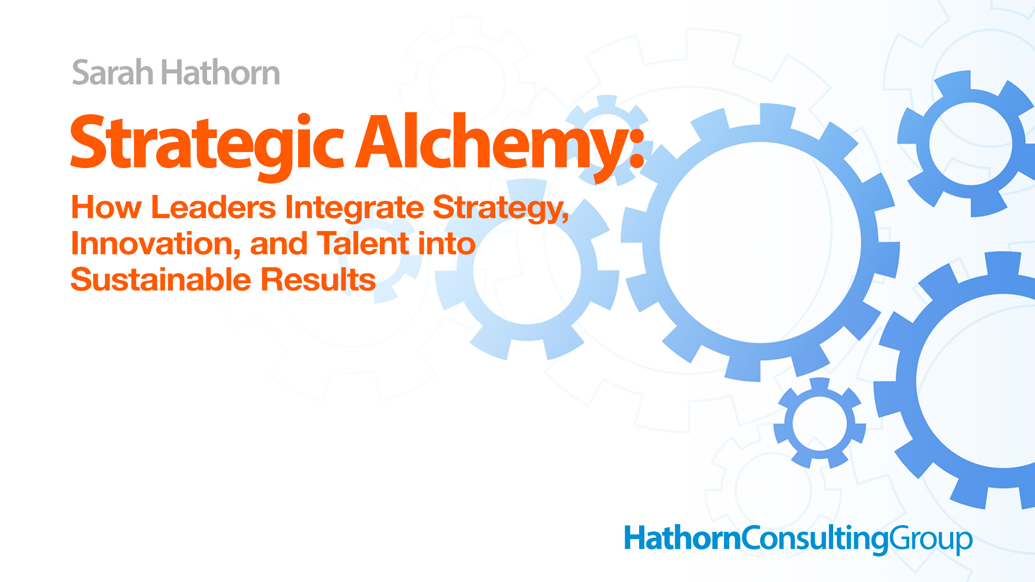
Copyright © 2026, Hathorn Consulting Group, All rights reserved.

Slide 2
If you stepped away from the organization tomorrow, would the mission stall, stabilize, or accelerate?

Slide 3
Strategy
Direction
Innovation
Relevance
Talent
Execution
Aligned leadership creates Strategic Alchemy

Slide 4





















Some of the companies we have worked with

Slide 5
Strategic Alchemy
Disciplined integration of:
Strategy
*
Innovation
*
Talent
Leadership the catalyst
Turning pressure into performance
Complexity & change into gold

Slide 6
SUSTAINABLE
RESULTS
TALENT
LEADERSHIP
STRATEGY
INNOVATION
TM

Slide 7
Leadership & Strategy: The Foundation
25%
75% of leaders have a 'plan' in a binder
But only 25% have a shared strategy that drives results
75%
(Source: Bridgespan Group)

Slide 8
Sentient Strategy®
Creating market-dominating strategies in turbulent times

Slide 9
Leadership & Innovation: The Foundation
3 Types of Innovation
Conformist
Opportunistic
Non-Conformist

Slide 10
Leadership & Innovation: The Foundation
0
10
20
30
40
50
60
70
80
90
100
Integrated Partnerships
Traditional Funding
Integrated Partnerships Outperform Traditional Funding by 40%
(Source: Stanford Social Innovation Review)

Slide 11
Leadership & Talent: The Elevation
“Legacy is not built by staying indispensable. It is built by developing leaders who can replace you.”
Sarah Hathorn

Slide 12
Leadership & Talent: The Elevation
27%
75%
70%
Only 27% of non-profits have a succession plan
75% of non-profit leaders expected to leave within next 5-10 years
70% unprepared for leadership transitions
(Source: Board Source & Building Movement Project)

Slide 13
Leadership & Discipline: Vision to Execution
Set Clear
Expectations:
Strategic Delegation:
Team Accountability:
Define success through explicit non-negotiable standards
Protect your altitude; delegate authority, not tasks
Manage measurable outcomes, not just admirable effort

Slide 14
Clear Expectations
If clear expectations are not:
Written
Discussed
Measured
Reinforced
They become optional!

Slide 15
Strategic Delegation
In the weeds? One of two things happening:
Hired below level required
Leading below level required

Slide 16
Team Accountability
When accountability is tied to outcomes:
Strategy gains traction
People perform at an optimal level
Performance becomes predictable

Slide 17


Future-Focused Talent Architecture
Copyright © 2025, Hathorn Consulting Group, All rights reserved.

Slide 18
Future Talent
23%
44%
23% of jobs will be redesigned by 2027
44% of core skills will be disrupted
6 in 10 employees will require reskilling
(Source: World Economic Forum, Future of Jobs Report)

Slide 19
Strategic Vacancies
Maintain the role as designed?
Restructure the function/ hierarchy?
Redesign it for future?
Allow technology and AI to absorb it?

Slide 20
If you stepped away from the organization tomorrow, would the mission stall, stabilize, or accelerate?

Slide 21
Strategy
Right focus that chooses the future
Innovation
Right ideas that create the future
Talent
Right people that build the future

Slide 22
The Legacy of Great Leadership. Build it NOW!

Slide 23
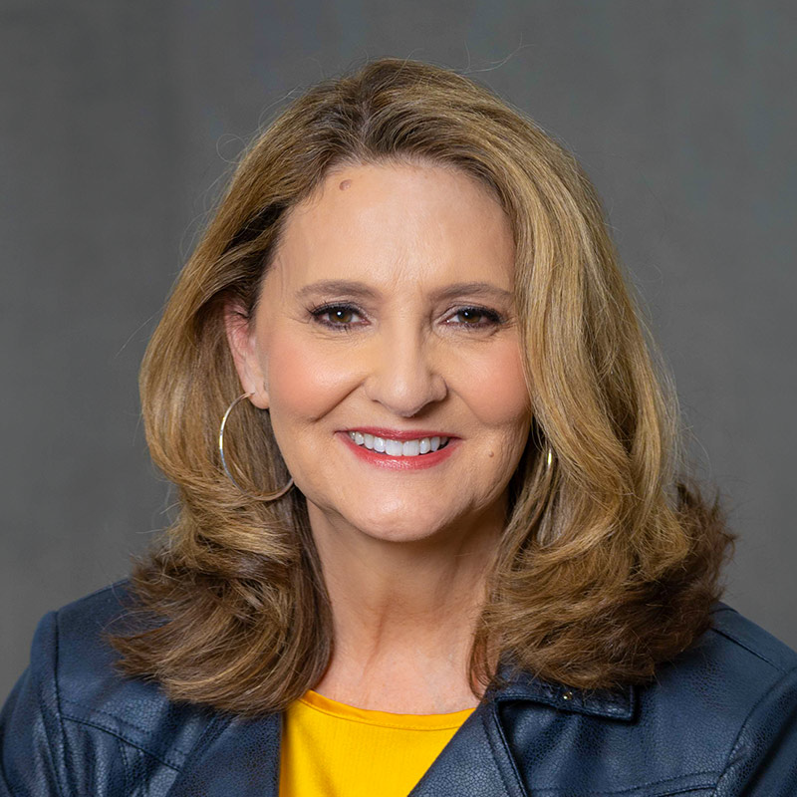
Sarah Hathorn
Hathorn Consulting Group
sarah@hathornconsultinggroup.com
800-267-3245
hathornconsultinggroup.com
linkedin.com/in/sarahhathorn/
youtube.com/@hathornconsulting

